Slide 1


Lecture 21
Produced by Dr. Worldwide
Welcome to the 305
~
~

Slide 2

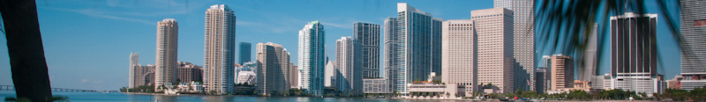
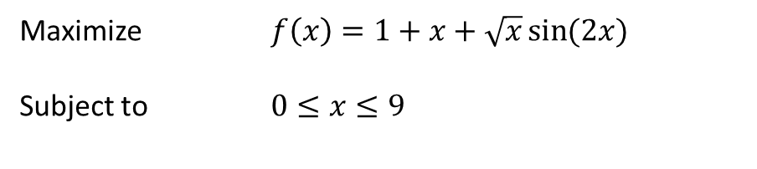
Multiple Maxima/Minima
When solving non-linear problems, it is important to consider the possibility that there may be multiple local solutions (maxima/minima)
There is no method that guarantees we find all such points
In problems not guaranteed to have a unique interior optimal solution, it is a good idea to run the GRG algorithm starting at several initial points
Consider the following nonlinear problem
Maximize $f\left(x\right)=1+x+\sqrt{x}\sin{(2x)}$
Subject to $0≤x≤9$

Slide 3
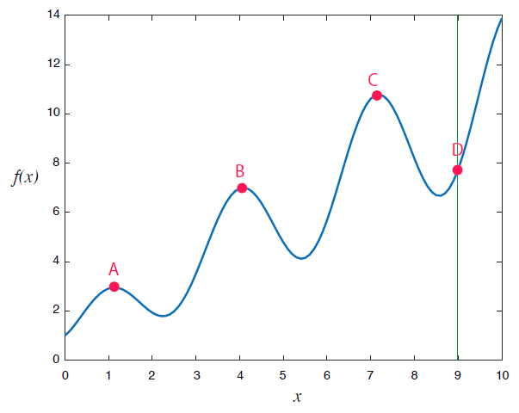
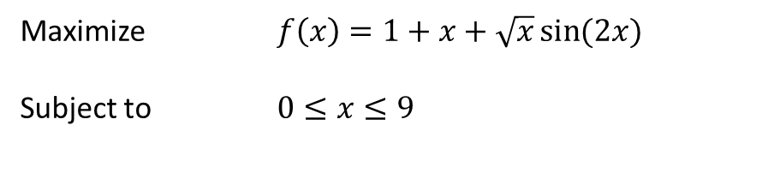

Multiple Maxima/Minima
Consider the graph
Four different local maxima
Q: What is the answer to our problem?
$$f\left(x\right)=1+x+\sqrt{x}\sin{(2x)}$$
Maximize $f\left(x\right)=1+x+\sqrt{x}\sin{(2x)}$
Subject to $0≤x≤9$

Slide 4

Multiple Maxima/Minima
Download MultipleMaxima.xlsx from link Sheet 1 on course website
Consider the following part of the spreadsheet
Run solver with four different starting values
Q: Do all four starting values lead to the same solution?
$$x=0, x=4, x=8, x=9$$

Slide 5
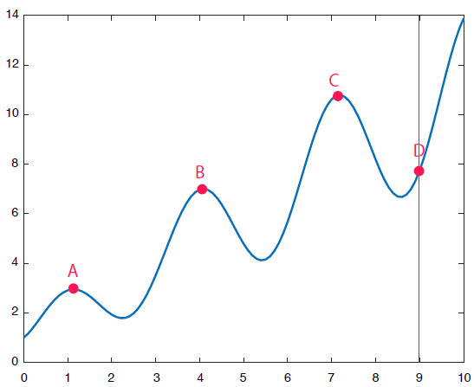
Multiple Maxima/Minima
Optimal solution under all initial values
Q: Do the answers make sense?
Starting Values | Optimal Solution | Maxima
0 | 1.13 | 2.95
4 | 4.08 | 7.01
8 | 7.18 | 10.79
9 | 9 | 7.75

Slide 6
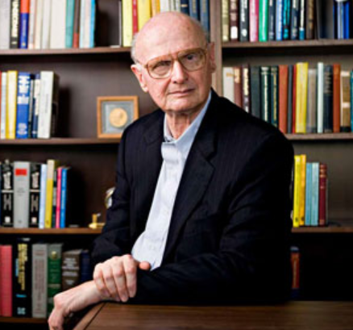
Ex: Investment Portfolio
An investor can choose among n different investment opportunities
An investment portfolio is a selection of how much to invest in each option
Popular model for portfolios is the Markowitz model
Minimize risk (variance of the portfolio)
Maximize return on investment
Different investments are assumed to be correlated
Positively correlated
Negatively correlated
Diversification protects against these correlations

Slide 7
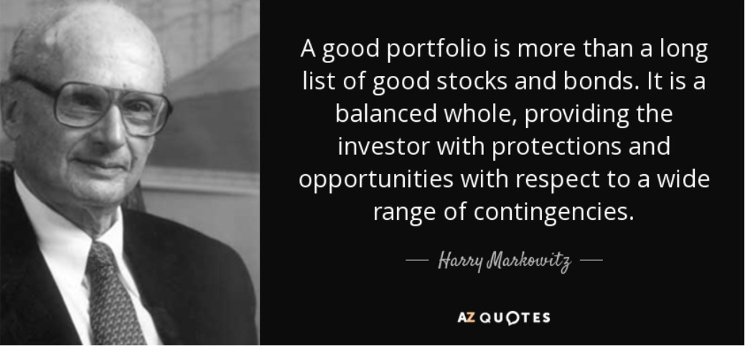
Ex: Investment Portfolio
Dope quote from Harry Markowitz

Slide 8
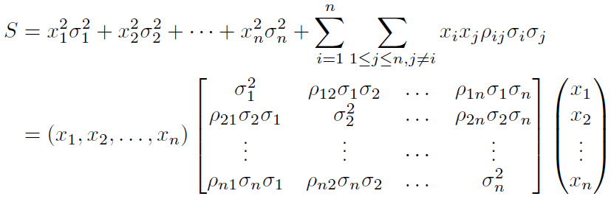
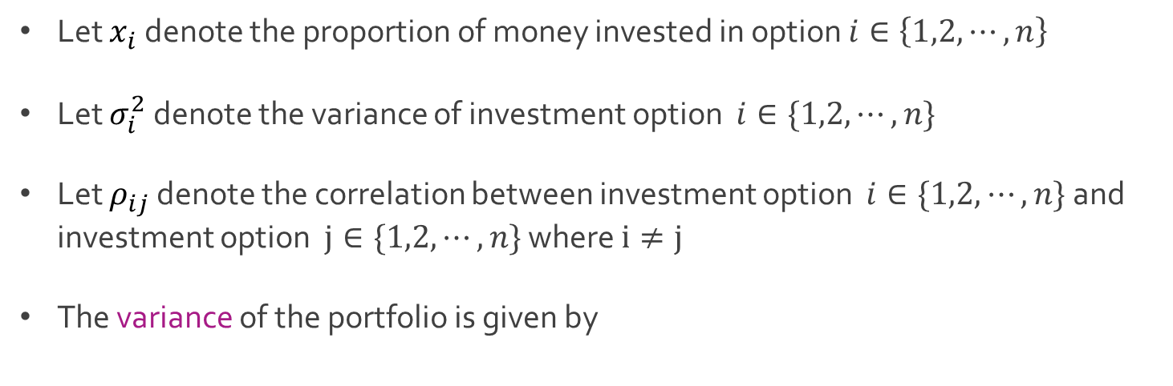
Ex: Investment Portfolio
Let $x_{i}$ denote the proportion of money invested in option $i∈\left\{1,2,⋯,n\right\}$
Let $σ_{i}^{2}$ denote the variance of investment option $i∈\{1,2,⋯,n\}$
Let $ρ_{ij}$ denote the correlation between investment option $i∈\{1,2,⋯,n\}$ and investment option $j∈\{1,2,⋯,n\}$ where $i≠j$
The variance of the portfolio is given by

Slide 9
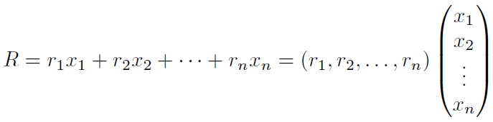
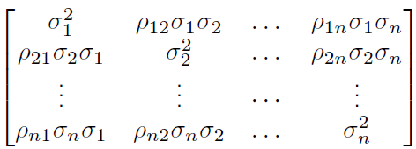
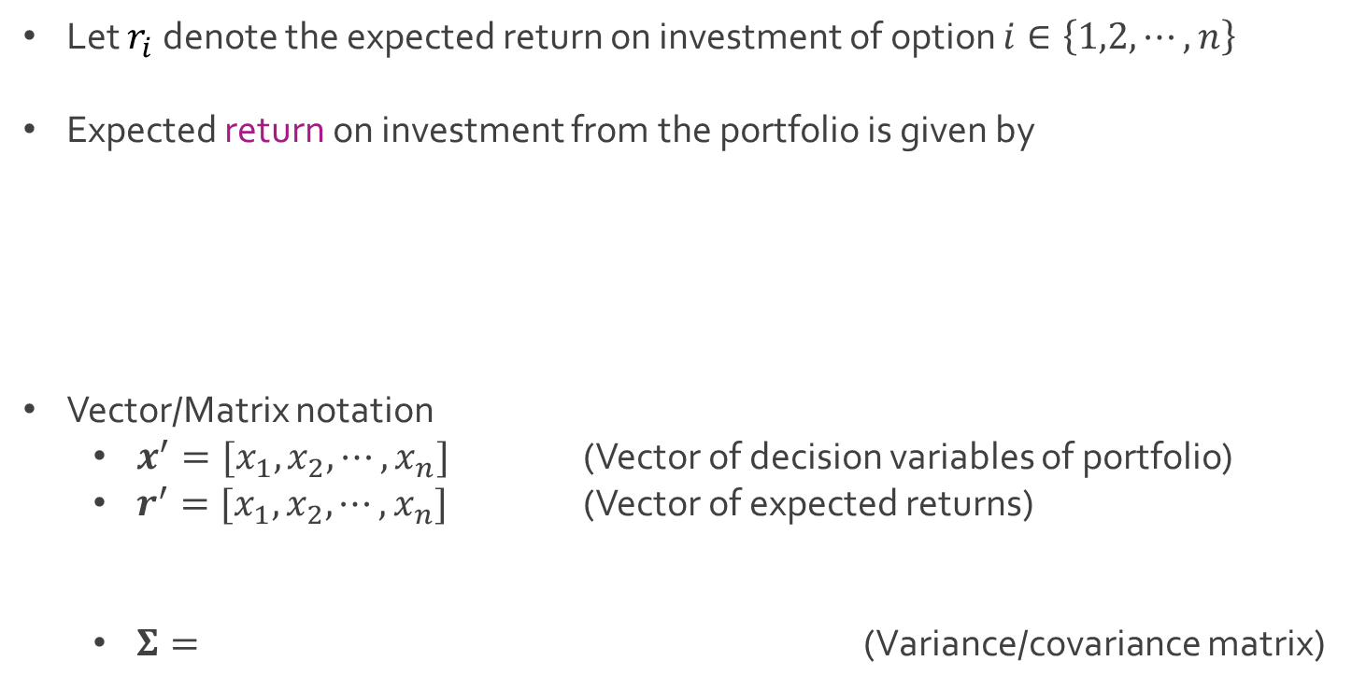
Ex: Investment Portfolio
Let $r_{i}$ denote the expected return on investment of option $i∈\left\{1,2,⋯,n\right\}$
Expected return on investment from the portfolio is given by
Vector/Matrix notation
$x^{′}=[x_{1}, x_{2},⋯, x_{n}]$ (Vector of decision variables of portfolio)
$r^{′}=[x_{1}, x_{2},⋯, x_{n}]$ (Vector of expected returns)
$Σ=$ (Variance/covariance matrix)

Slide 10
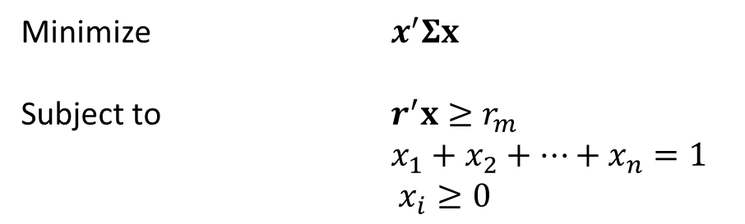
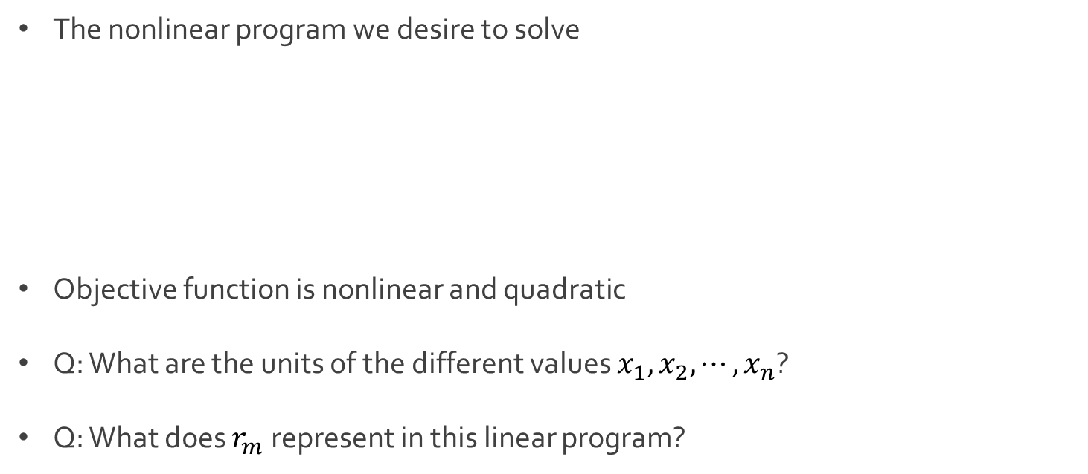
Ex: Investment Portfolio
The nonlinear program we desire to solve
Objective function is nonlinear and quadratic
Q: What are the units of the different values $x_{1},x_{2},⋯, x_{n}$?
Q: What does $r_{m}$ represent in this linear program?
Minimize $x^{′}Σx$
Subject to $r^{′}x≥r_{m}$
$x_{1}+x_{2}+⋯+x_{n}=1$
$x_{i}≥0$

Slide 11
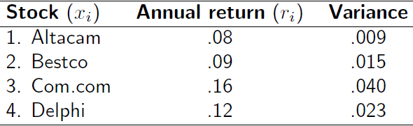
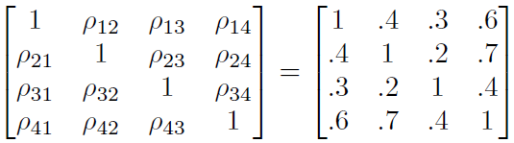
Ex: Investment Portfolio
Suppose an investor wants to build a portfolio from the following stocks:
Consider the correlation matrix of the stocks

Slide 12
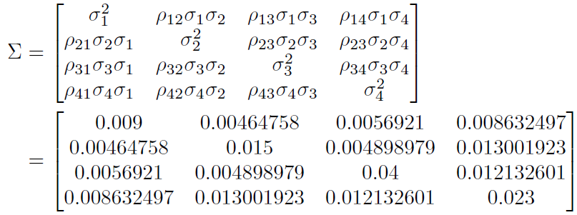
Ex: Investment Portfolio
The covariance matrix can be computed as follows:
The investor wants a total annual return of at least 0.11 (11%)
Download Markowitz.xlsx from link Sheet 2 on course website

Slide 13
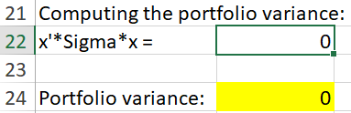

Ex: Investment Portfolio
Notice the formula for the objective function
Try the alternative approach
Examine what the constraints look like in Solver
= SUMPRODUCT(B4:B7,MMULT(A16:D19,B4:B7))
= MMULT(TRANSPOSE(B4:B7),MMULT(A16:D19,B4:B7))

Slide 14
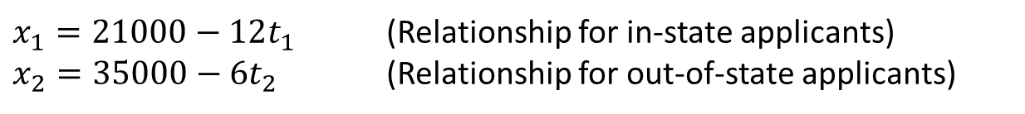
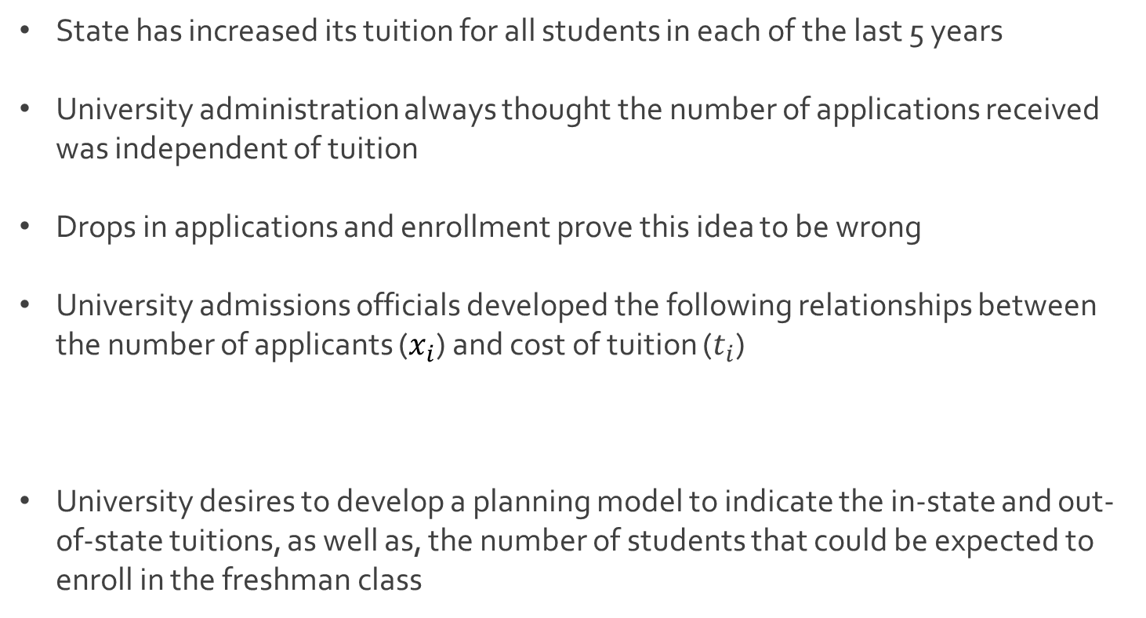
Ex: Admissions at State
State has increased its tuition for all students in each of the last 5 years
University administration always thought the number of applications received was independent of tuition
Drops in applications and enrollment prove this idea to be wrong
University admissions officials developed the following relationships between the number of applicants ($x_{i}$) and cost of tuition ($t_{i}$)
University desires to develop a planning model to indicate the in-state and out-of-state tuitions, as well as, the number of students that could be expected to enroll in the freshman class
$x_{1}=21000−12t_{1}$ (Relationship for in-state applicants)
$x_{2}=35000−6t_{2}$ (Relationship for out-of-state applicants)

Slide 15
Ex: Admissions at State
Constraints based on resources
Not enough classroom space for more than 1,400 students
Needs at least 700 freshmen to meet all its class size objectives
At most 800 dorm rooms available for freshmen
Historical expectations
55% of all in-state freshmen desire to live in dorms
72% of all out-of-state freshmen desire to live in dorms
Uphold the academic standards of the institution
Average SAT is 960 for in-state students
Average SAT is 1150 for out-of-state students
University wants the entering freshmen to average 1,000

Slide 16
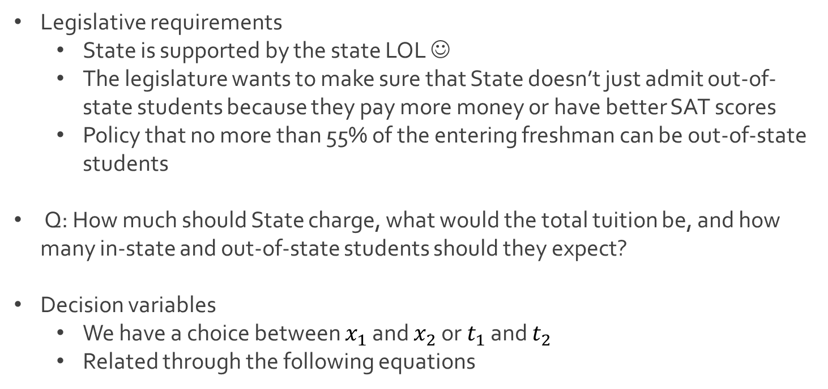
Ex: Admissions at State
Legislative requirements
State is supported by the state LOL ☺
The legislature wants to make sure that State doesn’t just admit out-of-state students because they pay more money or have better SAT scores
Policy that no more than 55% of the entering freshman can be out-of-state students
Q: How much should State charge, what would the total tuition be, and how many in-state and out-of-state students should they expect?
Decision variables
We have a choice between $x_{1}$ and $x_{2}$ or $t_{1}$ and $t_{2}$
Related through the following equations
$x_{1}=21000−12t_{1}$
$x_{2}=35000−6t_{2}$

Slide 17
Ex: Admissions at State
Objective function
Goal is to maximize the revenue in tuition
Total tuition based off in-state and out-of-state students
Constraints
Maximum number of freshmen
$x_{1}t_{1}+x_{2}t_{2}=x_{1}×\frac{\left(21000−x_{1}\right)}{12}+x_{2}×\frac{(35000−x_{2})}{6}$
$x_{1}+x_{2}≤1400$

Slide 18




The End
Dale

